Slide 1
Loss aversion bias
Win as if you were used to it,
lose as if you enjoyed it for a change.
—Ralph Waldo Emerson

Slide 2
Loss aversion bias
Loss aversion bias was developed by Daniel Kahneman and Amos Tversky in 1979 as part of the original prospect theory specifically, in response to prospect theory’s observation that people generally feel a stronger impulse to avoid losses than to acquire gains.

Slide 3
Behavioral Biases: Loss Aversion
Investors do not like losses and often engage in mental gymnastics to reduce their psychological impact.
Their tendency to sell a winning stock rather than a losing stock is called the disposition effect in behavioral finance literature

Slide 4
According to prospect theory,
people feel more strongly about the pain from loss
than pleasure from an equal gain.

Slide 5
Loss aversion
Pleasure
-10%
Small pleasure
Loss
Gain
+10%
Big pain
Pain

Slide 6
loss aversion
As applied to investments:
Tendency to sell winners too soon, and hang on to losers for too long
E.g.,3 i infotech
“If I haven’t realized the loss, then it isn’t yet a loss.”

Slide 7
Loss aversion bias
Loss aversion bias, observed in practice as the disposition effect, is seen often by wealth management practitioners.
Investors open up the monthly statements prepared by their advisors, skim columns of numbers, and usually notice both winners and losers.
In classic cases of loss aversion, clients dread selling the securities that haven’t performed well.

Slide 8
Loss aversion
People are pre-disposed to “get-evenitis”
Have difficulty in making peace with their losses
Also known as disposition effect: Propensity to lock in sure gains than to lock in sure loss
Individuals are more likely to sell stocks that have risen in price rather than those that have fallen in price (Odean 2001)
Stock that is up in value is 70% more likely to be sold than a stock that is down
A losing stock is held for a median of 124 days while a winning stock is held for a median of 102 days
Stocks that investors sold outperform the stocks that they held by 3.4% over the next 12 months

Slide 9
Myopic loss aversion
Currency hedging
Influenced by recent events or stick with long-term view
Limited set of metrics in evaluating investments
Can lead to over-estimation of risk

Slide 10
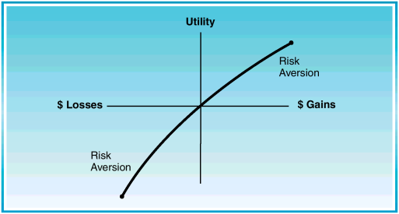
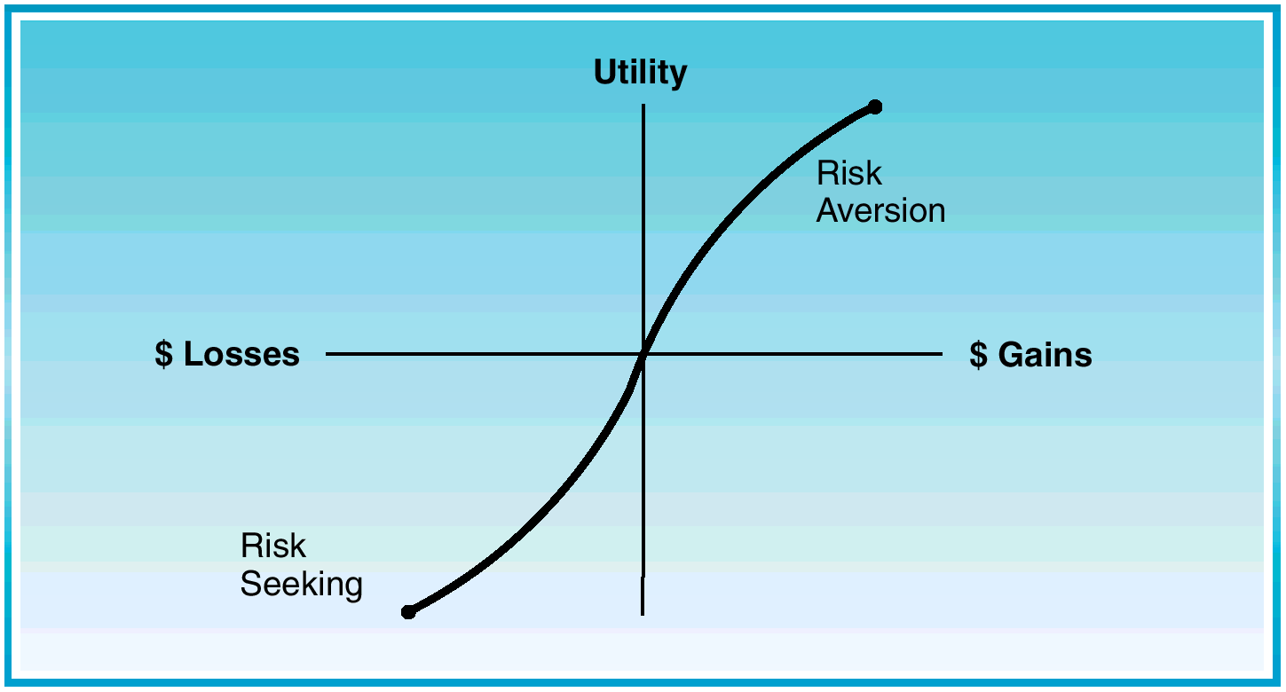

Slide 11
Prospect Theory:
Prospect theory proposed by Kahneman & Tversky describe how people frame & value a decision involving uncertainty .
According to prospect theory :
People look at choices in terms of potential gains or losses in relation to a specific reference point , which is often the purchase price .

Slide 12
Prospect Theory
Risk averse investors get increasing utility from higher levels of wealth, but at a decreasing rate.
Research shows that while risk aversion may accurately describe investor behavior with gains, investors often show risk seeking behavior when they face a loss

Slide 13
Loss Aversion Bias
Loss aversion bias was developed by Daniel
Kahneman and Amos Tversky in 1979 as part of the original prospect Theory
specifically, in response to prospect theory’s observation that people generally feel a stronger impulse to avoid losses than to acquire gains.

Slide 14
Psychologically, the possibility of a loss is on average twice as powerful a motivator as the possibility of making a gain of equal magnitude;
that is, a loss-averse person might demand, at minimum, a two-dollar gain for every one dollar placed at risk. In this scenario, risks that don’t “pay double” are unacceptable.

Slide 15
Loss aversion can prevent people from unloading unprofitable investments,
even when they see little to no prospect of a turnaround. Some industry
veterans have coined a diagnosis of “get-even-itis” to describe this
widespread affliction, whereby a person waits too long for an investment
to rebound following a loss.

Slide 16
Get-even-itis can be dangerous because,
often, the best response to a loss is to sell the offending security and to redeploy
those assets. Similarly, loss aversion bias can make investors dwell
excessively on risk avoidance when evaluating possible gains, since dodging
a loss is a more urgent concern than seeking a profit.

Slide 17
disposition effect
Loss aversion bias, observed in practice as the disposition effect, is seen
often by wealth management practitioners. Investors open up the
monthly statements prepared by their advisors, skim columns of numbers,
and usually notice both winners and losers. In classic cases of loss
aversion, clients dread selling the securities that haven’t performed well.
Get-even-itis takes hold, and the instinct is to hold onto a losing investment
until, at the very least, it rebounds enough for the client to break
even. Often, however, research into a losing investment would reveal a
company whose prospects don’t forecast a rebound. Continuing to hold
stock in that company actually adds risk to an investor’s portfolio

Slide 18
Prospect theory is a collection of explanations for observed exceptions to standard economic assumptions:
that people’s preferences are orderly and conform to a general law of diminishing returns (strict convexity, for those of a mathematical bent), and
that human behavior is “rational” in that choices can reasonably be expected to accomplish the decisionmaker’s goals

Slide 19
And how do people value gain/losses? They value gains/losses according to a S-Shaped utility function . Features of the utility function :
The utility function is concave for gains . This means that people feel good when they gain, but twice the gain does not make them feel twice as good .
The utility function is convex for losses . This means that people experience pain when they lose , but twice the loss does not mean twice the pain .
The utility function is steeper for losses than for gains . This means that people feel more strongly about the pain from a loss than the pleasure from an equal gain- about two & half times strongly . This phenomenon to as loss aversion

Slide 20
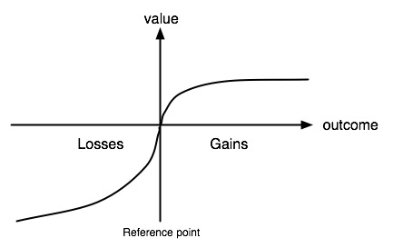

Slide 21
Example: Consider a choice of A or B, where A yields a 3/4 chance at +$6,000 and 1/4 chance at zero, while B yields a sure +$4,000. In surveys, the majority (roughly 80%) of respondents select B [the sure +$4000] instead of A [which has an expected value of +$4500]. This pattern reflects risk averse behavior.
Now keep the same expected absolute values but change the expected gains into expected losses. Suppose choice C now yields a certain loss of $4,000, while choice D entails a 5% chance of losing $90,000, and a 95% chance of losing nothing. [Assume you can take out a mortgage if you lose.] Although the expectation of loss with choice D is – $4,500, roughly two-thirds of respondents choose option D as preferable to option C, with its certain loss of $4,000. The choice of option D reflects loss averse or risk-seeking behavior.

Slide 22
The lesson from this part of prospect theory may be that many people are far more willing to engage in risky behavior to avoid potential losses than they are willing to take risks to improve their positions.
This pattern of paired choices is inconsistent with some standard economic assumptions about our preference functions .
Thus, Prospect theory is a theory of decision making under the condition of risk .decision are based on judgments.
Prospect theory directly addresses how these choices are framed & evaluated in the decision making process.

Slide 23
Loss aversion causes investors to hold losing investments too
long. This behavior is sometimes described in the context of a
debilitating disease: get-even-itis. This is the affliction in which
investors hold losing investments in the hope that they get back
what they lost. This behavior has seriously negative consequences
by depressing portfolio returns

Slide 24
Loss aversion can cause investors to sell winners too early, in
the fear that their profit will evaporate unless they sell. This
behavior limits upside potential of a portfolio, and can lead to
too much trading, which has been shown to lower investment
returns.

Slide 25
Loss aversion can cause investors to unknowingly take on more
risk in their portfolio than they would if they simply eliminated
the investment and moved into a better one (or stayed in cash).

Slide 26
4. Loss aversion can cause investors to hold unbalanced portfolios.
If, for example, several positions fall in value and the investor
is unwilling to sell due to loss aversion, an imbalance
can occur. Without proper rebalancing, the allocation is not
suited to the long-term goals of the client, leading to suboptimal
returns.

Slide 27
Beware: Holding losing stocks for too long is harmful to
your investment health. One symptom of get-even-itis is that a client’s
decision making regarding some investments seems to be dependent on
the original price paid for that investment. One effective remedy is a stoploss
rule. You may, for example, agree to sell a security immediately if it
ever incurs a 10 percent loss. However, it’s best to consider an investment’s
normal, expected levels of volatility when devising a stop-loss
rule. You don’t want to be forced to sell if an investment’s price is just exhibiting
its customary ups and downs.

Slide 28
Take the Money and Run. Loss aversion can cause investors to sell winning
positions too early, fearing that that their profits will evaporate
otherwise. This behavior limits the upside potential of a portfolio and
can lead to overtrading (which also reduces returns). Just as stop-loss
rules can help to combat get-even-itis, it is often helpful to institute
rules for selling appreciating investments. As with stop-loss rules, priceappreciation
rules work best when tailored to reflect details related to
fundamentals and valuation. The goal is to let gains run. Remember,
too, that in a taxable account, you should avoid paying taxes on appreciations
as long as possible.

Slide 29
Taking on Excessive Risk. Loss aversion can cause investors to hold onto
losing investments even in companies that are in serious trouble. In such
a case, it may be helpful to educate clients about an investment’s risk profile—
taking time to discuss items like standard deviation, credit rating,
buy/sell/hold ratings, and so on. The investor will then, hopefully, make
the right decision to protect the overall portfolio and jettison the risky,
poorly performing investment.
Unbalanced Portfolios. Loss aversion can cause investors to hold unbalanced
portfolios. Education about the benefits of asset allocation and diversification
is critical, yet it may be insufficient if an investor holds a
concentrated stock position with emotional strings attached. A useful
question in this situation is: “If you didn’t own any XYZ stock today,
would you still want to pick up as many shares as you own right now?”
If and when the answer is “no,” some leeway for maneuvering emerges.
Tax considerations, such as low cost basis, sometimes factor in; but certain
strategies can be employed to manage this cost.

Slide 30
Regret Theory
Prospect of regret pain generates avoidance behavior
People avoid selling stocks that have gone down in value, rush to sell those that have gone up (disposition effect).

